Slide 1


Green Pace
Security Policy Presentation
Developer: Orion J. Murray

Slide 2

OVERVIEW: DEFENSE IN DEPTH

Slide 3
OVERVIEW: DEFENSE IN DEPTH
GOALS
Prevent common code vulnerabilities.
Enforce best practices consistently.
Ensure compliance with industry regulations.
Consider security every step of the way.

Slide 4

10 PRINCIPLES
1. Validate Input Data
2. Heed Compiler Warnings
3. Architect and Design for Security Policies
4. Keep It Simple
5. Default Deny
6. Adhere to the Principle of Least Privilege
7. Sanitize Data Sent to Other Systems
8. Practice Defense in Depth
9. Use Effective Quality Assurance Techniques
10. Adopt a Secure Coding Standard

Slide 5

CODING STANDARDS
STD-001-CPP: Data Type
1: Validate Input Data
STD-002-CPP: Data Value
1: Validate Input Data
STD-003-CPP: String Correctness
7: Sanitize Data Sent to Other Systems
STD-004-CPP: SQL Injection
1: Validate Input Data
7: Sanitize Data Sent to Other Systems
STD-005-CPP: Memory Protection
8: Practice Defense in Depth,
10: Adopt a Secure Coding Standard
STD-006-CPP: Assertions
2: Heed Compiler Warnings
9: Use Effective Quality Assurance Techniques
STD-007-CPP: Exceptions
3: Architect and Design for Security Policies
9: Use Effective Quality Assurance Techniques
STD-008-CPP: Input Sanitization
8: Practice Defense in Depth
10. Adopt a Secure Coding Standard
STD-009-CPP: Error Logging
3: Architect and Design for Security Policies
5: Default Deny
STD-010-CPP: Secure Random Number Generation
8: Practice Defense in Depth
10: Adopt a Secure Coding Standard

Slide 6
THREATS MATRIX
Likely | Priority
Low priority | Unlikely

Slide 7
THREATS MATRIX
Likely | Priority
Low priority | Unlikely
STD-002-CPP: Data Value
STD-003-CPP: String Correctness
STD-004-CPP: SQL Injection
STD-001-CPP: Data Type
STD-002-CPP: Data Value
STD-003-CPP: String Correctness
STD-004-CPP : SQL Injection
STD-005-CPP: Memory Protection
STD-007-CPP: Exceptions
STD-008-CPP : Input Sanitization
STD-009-CPP: Error Logging
STD-010-CPP: Secure Random Number Generation
STD-006-CPP : Assertions
STD-001-CPP: Data Type
STD-005-CPP : Memory Protection
STD-006-CPP: Assertions
STD-007-CPP : Exceptions
STD-008-CPP: Input Sanitization
STD-009-CPP: Error Logging
STD-010-CPP : Secure Random Number Generation

Slide 8
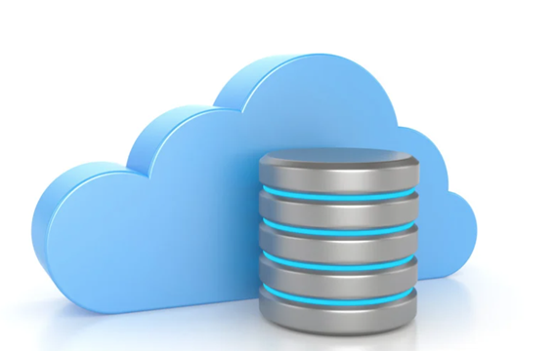
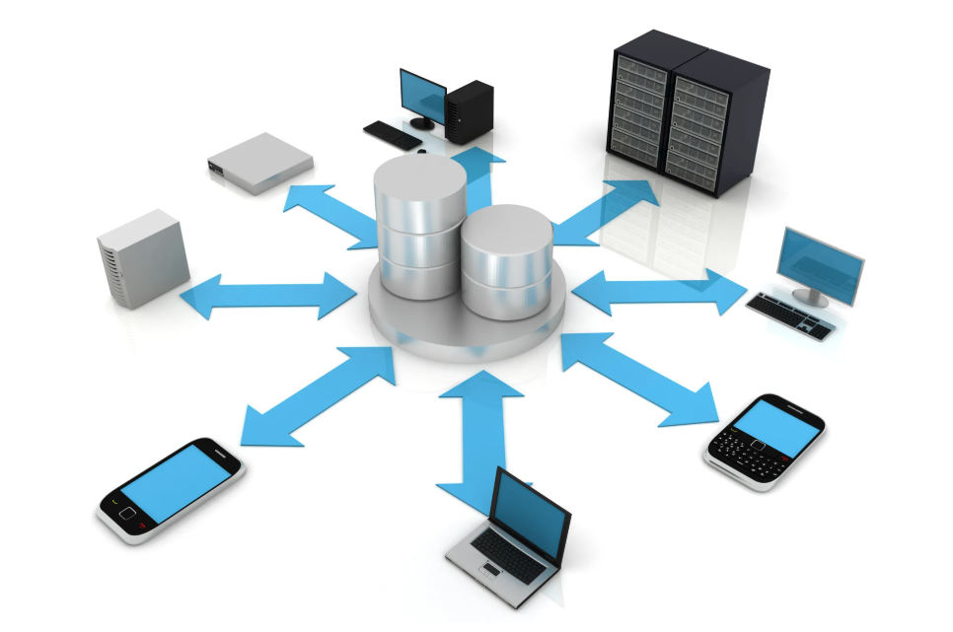
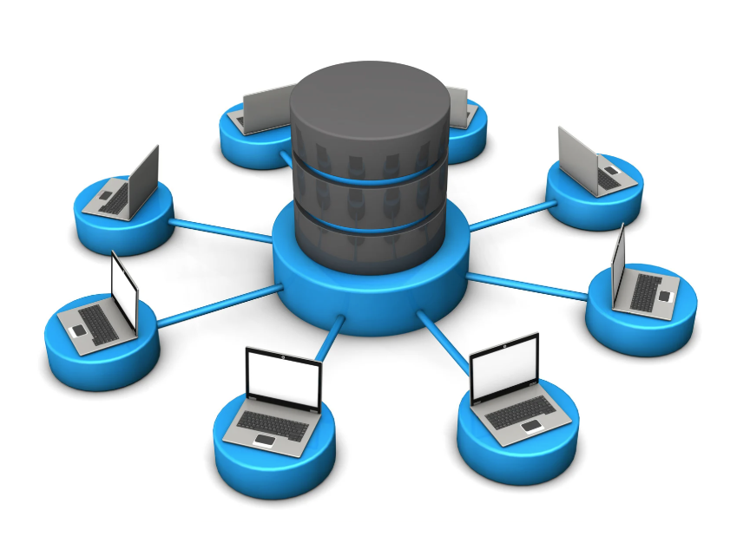
ENCRYPTION POLICIES
Encryption at rest – Protects data while it’s stored on disks, databases, or other storage media.
Encryption in flight – Secures data as it’s transmitted between systems or devices.
Encryption in use - Protects data while it’s actively being processed in memory.

Slide 9
TRIPLE-A POLICIES
Authentication
Authorization
Accounting
Verifying user identity prevents unauthorized access.
Strong Passwords
Biometrics
Multi-factor Authentication\SSO
Controlling access based on user roles ensures that individuals only have the minimum privileges necessary to perform their tasks.
Role-Based Access Control (RBAC)
Attribute-Based Access Control (ABAC)
Ensure auditability and early detection of security incidents.
Logging & Audting
Monitoring
Automation of analyzation

Slide 10
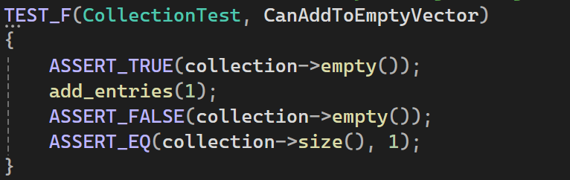
Can We Add to an Empty Collection?
Vulnerability Addressed
Potential overflow or out-of-bounds issues if adding items isn’t handled correctly.
Implementation (Positive Test)
Start with an empty vector/collection.
Add a single item.
Check that the collection is no longer empty and its size is exactly
Result
Passed: The collection successfully stores the new item.
This confirms no overflow and that the container handles basic insertions correctly.

Slide 11
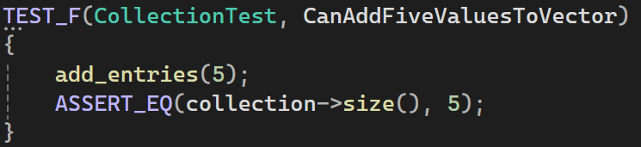
What Happens When We Add Multiple Items?
Vulnerability Addressed
Potential buffer overflow if capacity isn’t adjusted properly as items are added.
Implementation (Positive Test)
Start with an empty collection.
Add five values in a loop.
Confirm the size is now 5, and each item matches the inserted values.
Result
Passed: The container’s size and stored values are correct.
Demonstrates proper dynamic resizing and prevention of out-of-bounds errors during typical use.

Slide 12
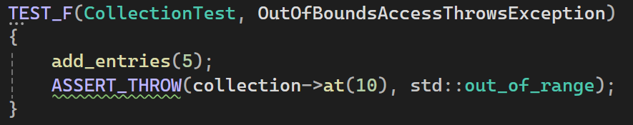
Does Out-of-Bounds Access Throw an Exception?
Vulnerability Addressed
Out-of-bounds or buffer overflow, which can crash the program or cause silent data corruption.
Implementation (Negative Test)
Add five items to the collection.
Attempt to access an index well beyond the valid range (e.g., index 99).
Expect a std::out_of_range exception.
Result
Passed: The code correctly threw an exception for an invalid index.
Confirms the collection defends against out-of-bounds errors by design.

Slide 13
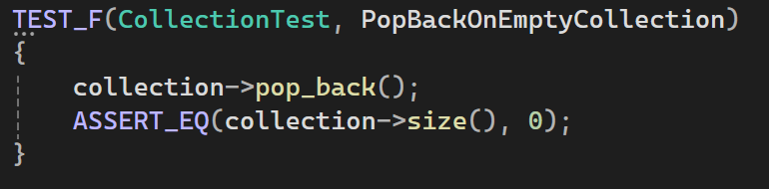
Does Pop Back on an Empty Collection Cause Errors?
Vulnerability Addressed
Invalid memory access or underflow if pop_back tries to remove an item from an empty buffer.
Implementation (Negative Test)
Initialize an empty collection.
Call pop_back() immediately.
Ensure it does not crash and that size remains zero.
Result
Passed: No crash occurred, and size stayed 0.
Shows robust edge-case handling, preventing potential memory errors.

Slide 14
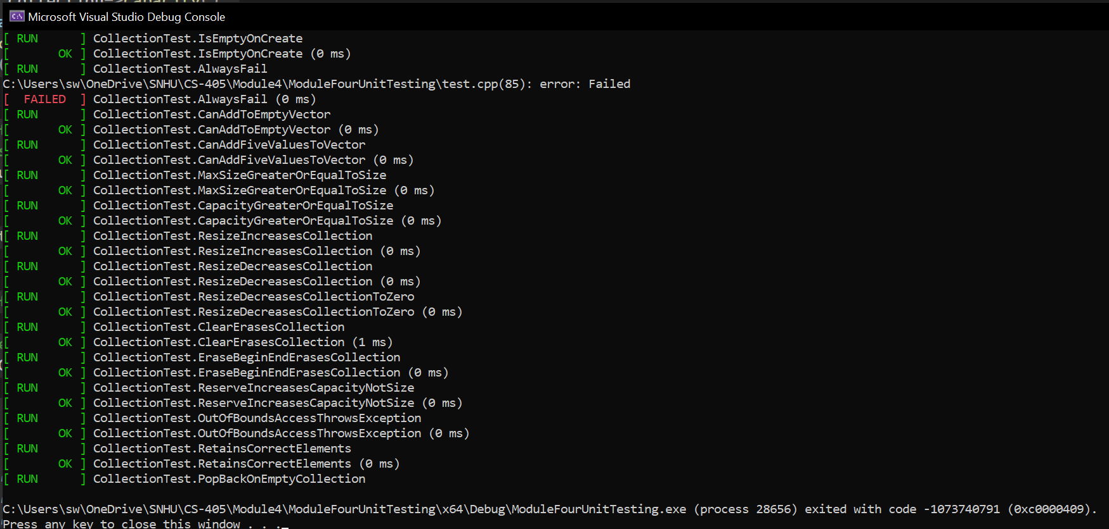
Unit Test Output

Slide 15

AUTOMATION SUMMARY

Slide 16
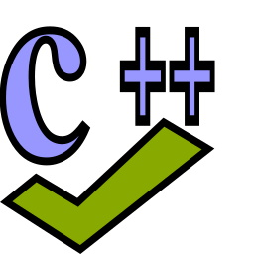
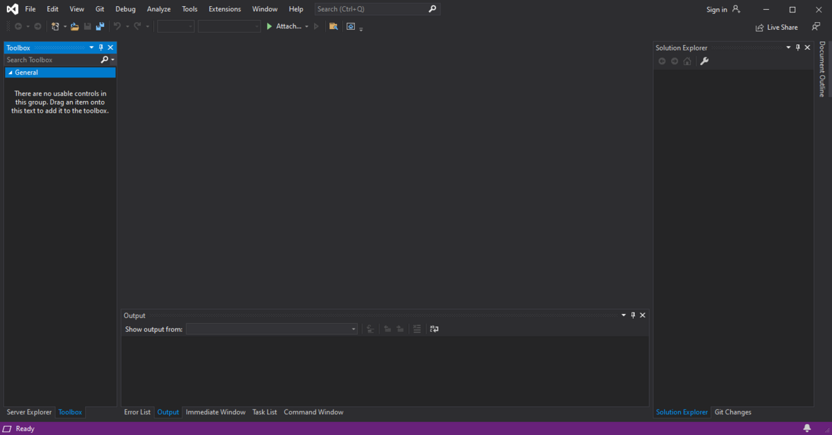

TOOLS
Tools Used:
Cppcheck
Visual Studio
Sonar Rules static code analysis

Slide 17
RISKS AND BENEFITS
RISKS
BENEFITS
Late discovery of vulnerabilities
Higher remediation costs
Increased chances of breaches
Adopts early vulnerability detection
Supports regulatory compliance
Enhanced system resilience

Slide 18
RECOMMENDATIONS
Expand Policy Coverage - Define security guidelines for all applications, frameworks, and cloud environments.
Automate Security in DevSecOps - Integrate SAST, DAST, dependency scans, and runtime monitoring in pipelines.
Establish a Formal Incident Response Plan – Define roles, escalation paths, containment steps, and rollback procedures.
Secure Third-Party Integrations – Require regular audits and automated security checks for external libraries & APIs.
Strengthen Identity & Access Controls – Implement Zero Trust, role-based access (RBAC/ABAC), and MFA enforcement.

Slide 19
CONCLUSIONS
NIST Cybersecurity Framework (CSF) – Provides a structured approach for managing cybersecurity risk across all stages of development and deployment.
ISO 27001 – Ensures a well-defined Information Security Management System (ISMS) for governance, risk management, and compliance.
OWASP Secure Coding Practices – Establishes secure development guidelines for web applications and APIs to prevent injection attacks, misconfigurations, and security loopholes.
CIS Critical Security Controls – Outlines industry best practices for hardening systems, enforcing least privilege, and securing network access.
GDPR / HIPAA Compliance Standards – Ensures proper handling and encryption of sensitive user data, aligning with global privacy laws.

Slide 20
REFERENCES
Dunham, R. (2020, May 5). Information security policies: Why they are important to your organization. Linford & Co. LLP. https://linfordco.com/blog/information-security-policies/
Murray, A. (2020, June 13). Secure coding: A practical guide. Mend.io. https://www.mend.io/blog/secure-coding/
Federal Trade Commission. (n.d.). Start with security: A guide for business. https://www.bulkorder.ftc.gov/publications/start-security-guide-business
Seacord, R., & Schiela, R. (2018, May 2). Top 10 secure coding practices. Software Engineering Institute, Carnegie Mellon University. https://wiki.sei.cmu.edu/confluence/display/seccode/Top+10+Secure+Coding+Practices
Microsoft. (2021, August 2). Security best practices for C++. Microsoft Learn. https://learn.microsoft.com/en-us/cpp/security/security-best-practices-for-cpp
Britton, J. (2021, April 26). STR53-CPP. Range check element access. Software Engineering Institute, Carnegie Mellon University. https://wiki.sei.cmu.edu/confluence/display/cplusplus/STR53-CPP.+Range+check+element+access

